Slide 1
Intelligent Systems Project Presentation Erfan Panahi | Amirhussain Birzhandi

Slide 2
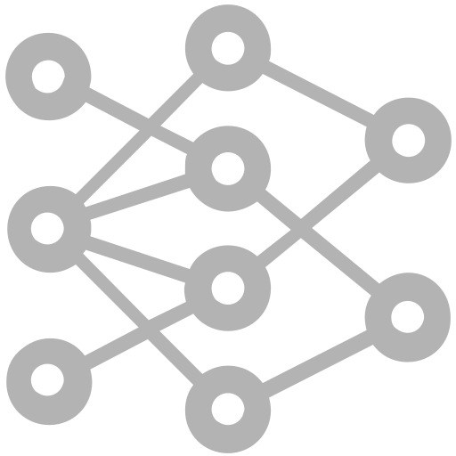

Project analysis slide 2
Project Overview
Introduction to
RL-GANs
Implementing the Connect4 Using
Deep Q-Learning
GANs
Deep Q-Learning
PROJECT
B
Architecture of RL-GANS
Connect 4
Algorithm of RL-GAN
Implementation & Results

Slide 3
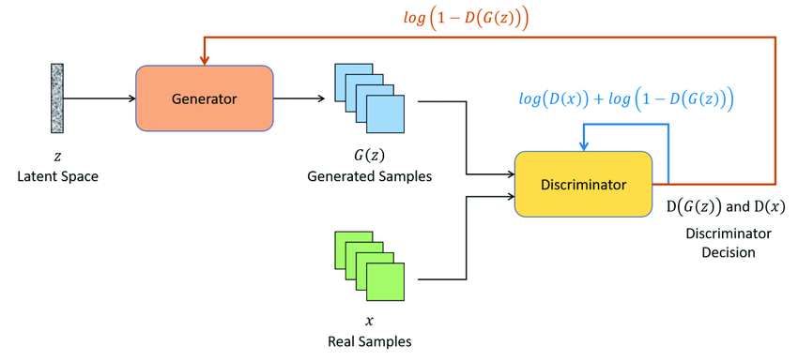
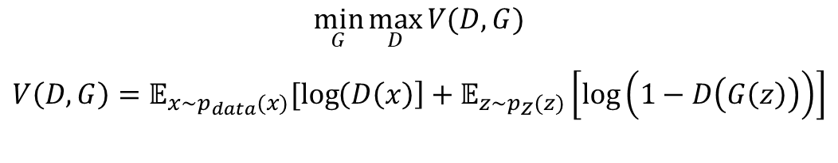
Part 1
Introduction to RL-GANs
GANs
Generative Adversarial Network
$$\min_{G}{\max_{D}{V(D,G)}}$$
$$V\left(D,G\right)=𝔼_{x\sim p_{data}(x)}[\log\left(D\left(x\right)\right]+𝔼_{z\sim p_{Z}(z)}\left[\log\left(1−D\left(G\left(z\right)\right)\right)\right]$$

Slide 4
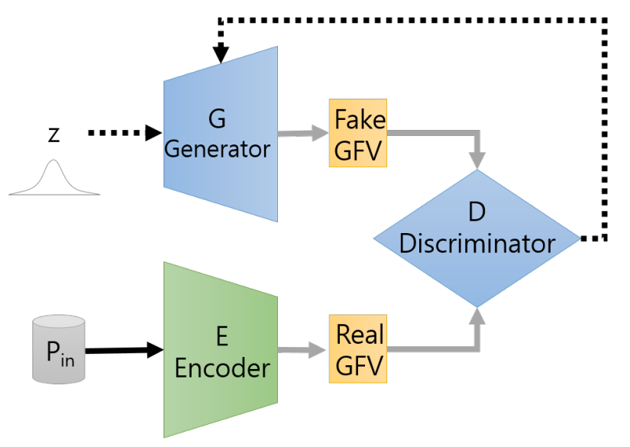
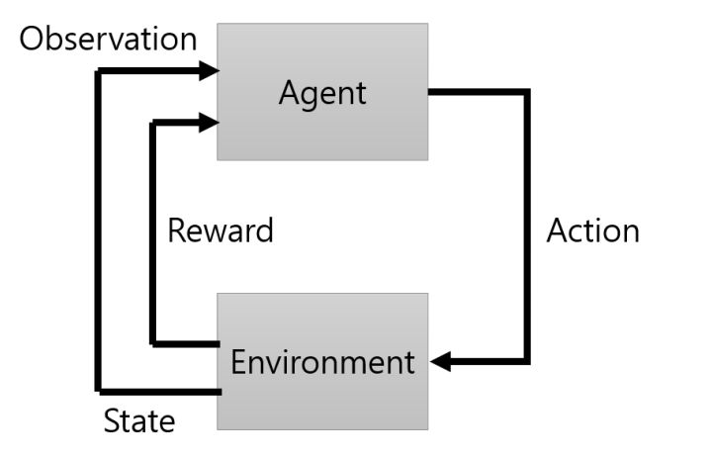
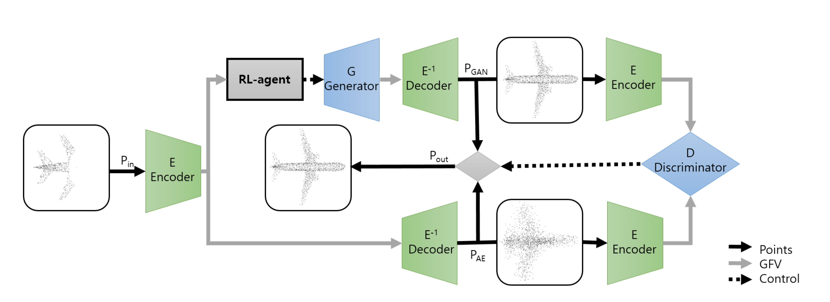
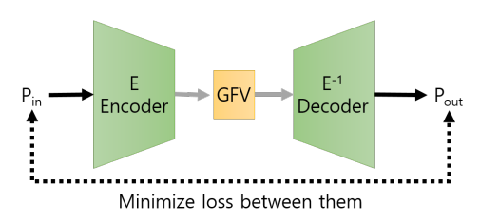
Architecture of RL-GANS
Latent space GAN
RL
Auto Encoder
RL-GAN-Net: A Reinforcement Learning Agent Controlled GAN Network for Real-Time Point Cloud Shape Completion

Slide 5
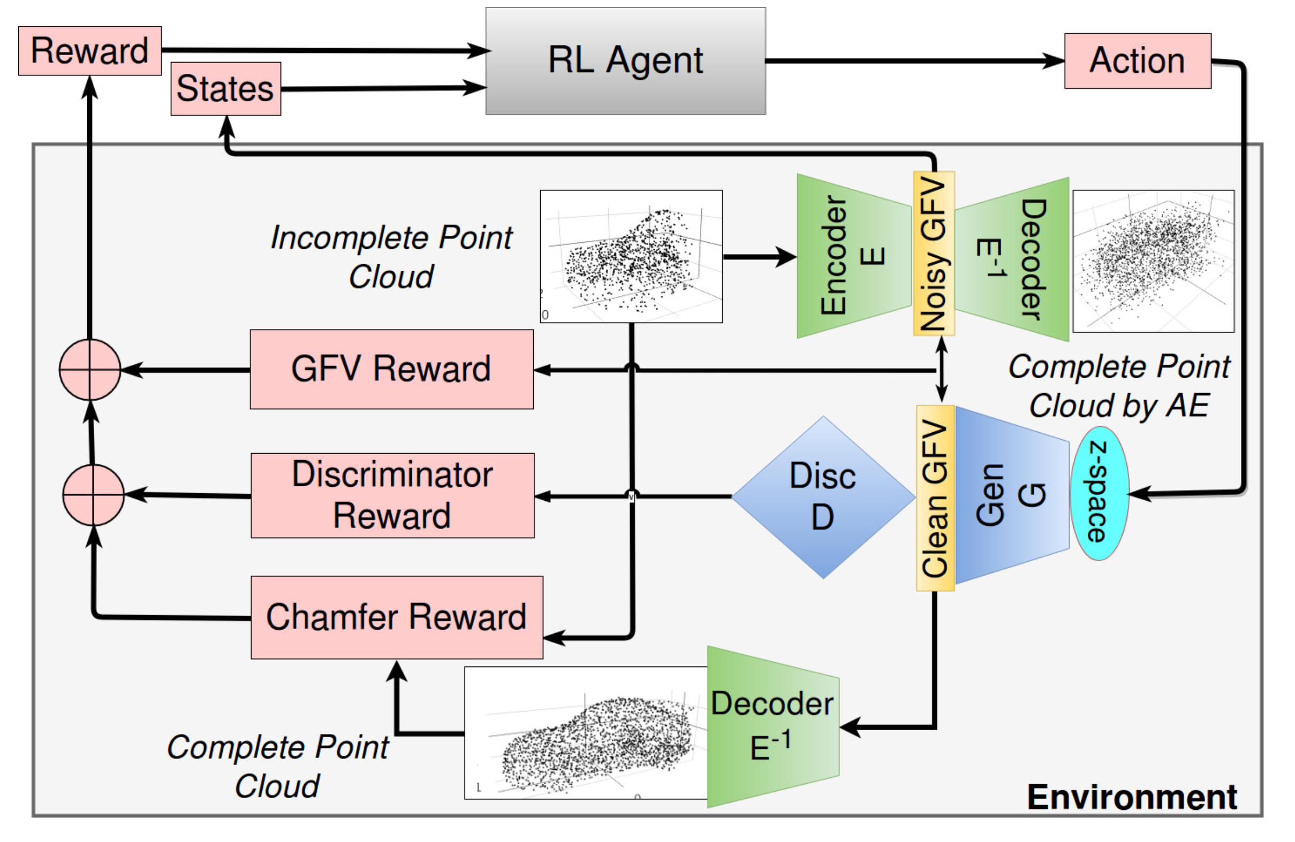
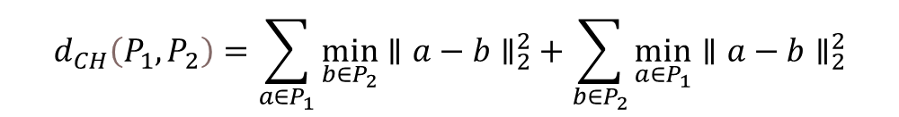
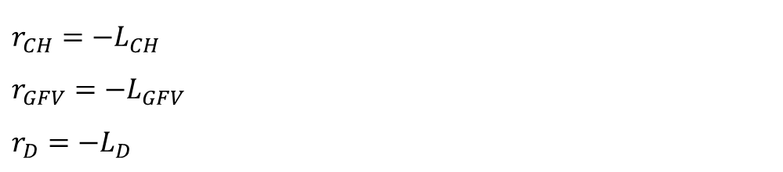
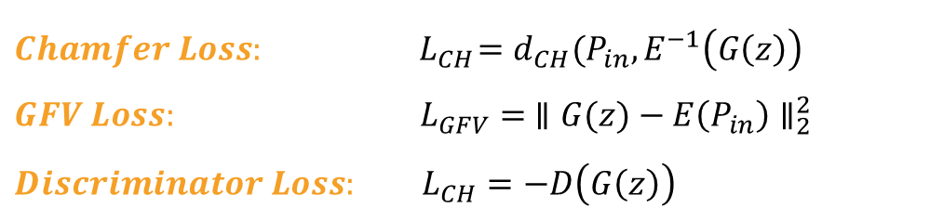
Architecture of RL-GANS
$$d_{CH}\left(P_{1},P_{2}\right)=\sum_{a∈P_{1}}{\min_{b∈P_{2}}{∥a−b∥_{2}^{2}}}+\sum_{b∈P_{2}}{\min_{a∈P_{1}}{∥a−b∥_{2}^{2}}}$$
$$Chamfer Loss: { L}_{CH}=d_{CH}(P_{in}, E^{−1}\left(G\left(z\right)\right)$$
$$GFV Loss: L_{GFV}= ∥G(z)−E\left(P_{in}\right)∥_{2}^{2}$$
$$Discriminator Loss: L_{CH}=−D\left(G\left(z\right)\right)$$
$$r_{CH}=−L_{CH}$$
$$r_{GFV}=−L_{GFV}$$
$$r_{D}=−L_{D}$$
$$r=ω_{CH}.r_{CH}+ω_{GFV}.r_{GFV}+ω_{D}.r_{D}$$

Slide 6
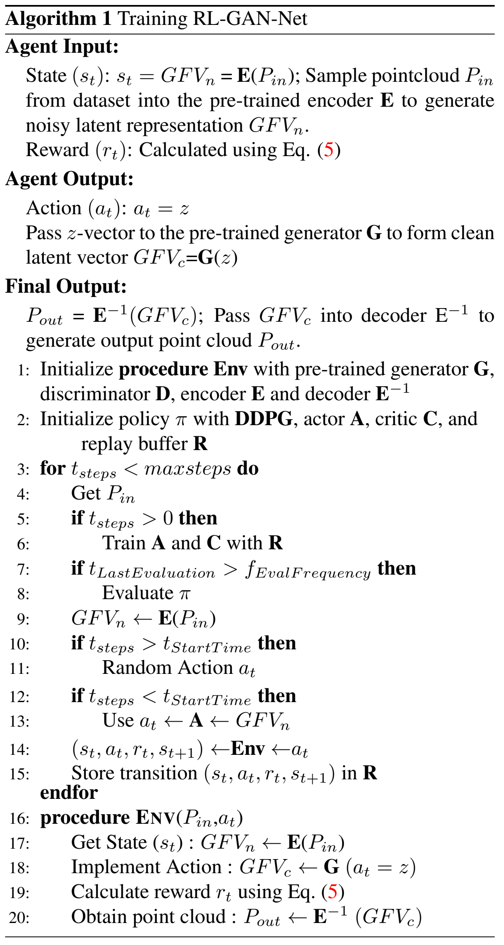
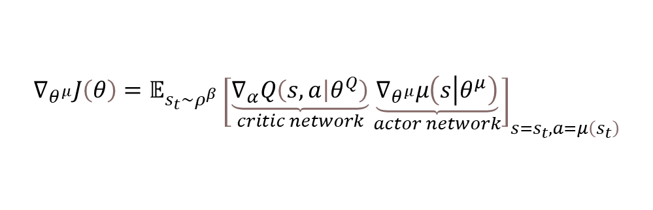
Algorithm of RL-GAN
Deep Deterministic Policy Gradient
$$∇_{θ^{μ}}J\left(θ\right)=𝔼_{s_{t}\sim ρ^{β}}{\left[\underset{critic network}{\underbrace{∇_{α}Q\left(s,a | θ^{Q}\right)}}\underset{actor network}{\underbrace{∇_{θ^{μ}}μ\left(s\left|θ^{μ}\right.\right)}}\right]}_{s=s_{t}, a=μ\left(s_{t}\right)}$$

Slide 7
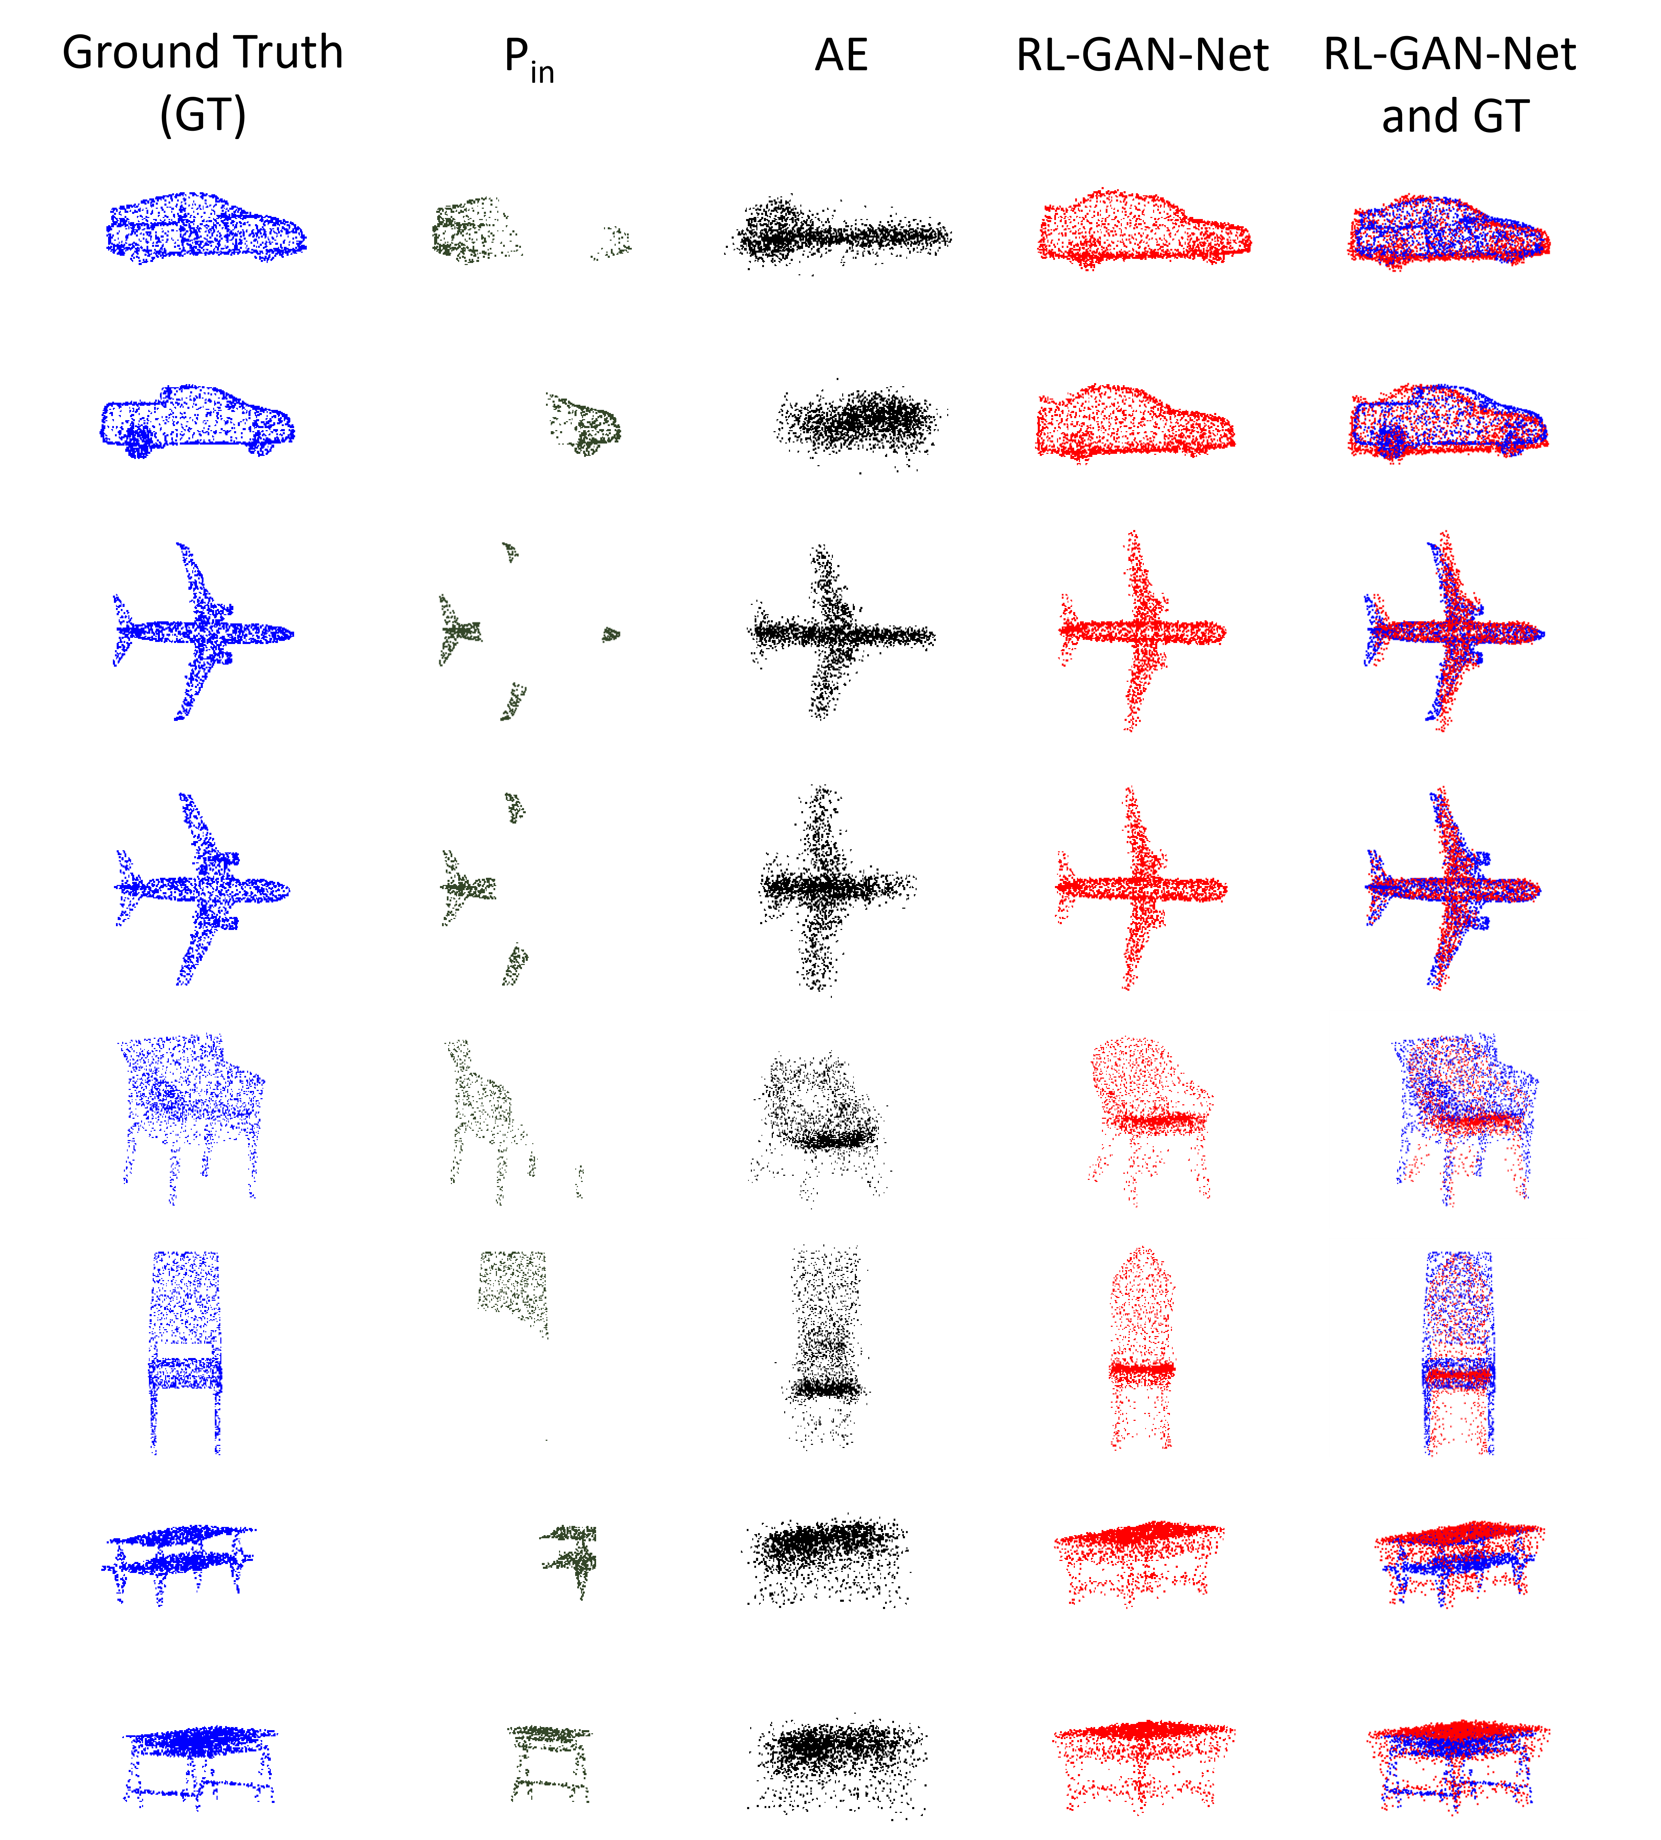
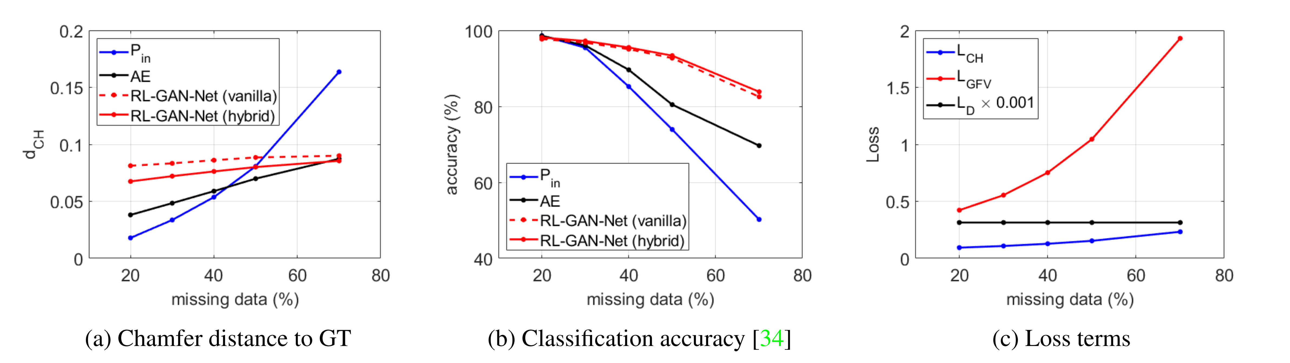
Performance Analysis
Qualitative results of point cloud shape completion given input data missing 70% of its original points.

Slide 8
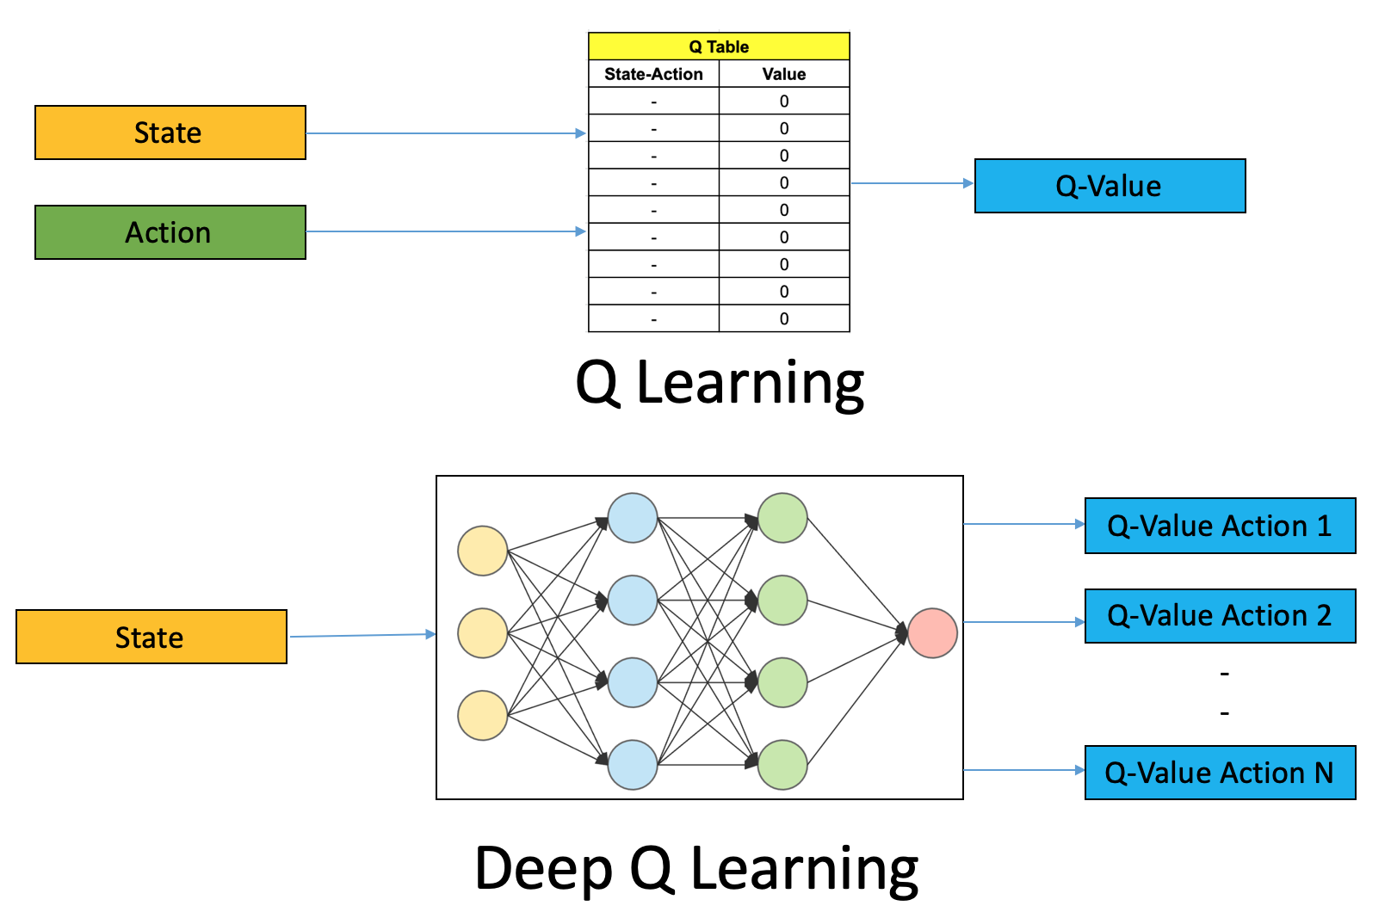
Part 2
Implementing the Connect4 Using Deep Q-Learning
Deep Q-Learning
Deep Q-Learning uses the Q-learning idea and takes it one step further. Instead of using a Q-table, we use a Neural Network that takes a state and approximates the Q-values for each action based on that state.
Reference: https://www.assemblyai.com/blog/reinforcement-learning-with-deep-q-learning-explained/

Slide 9
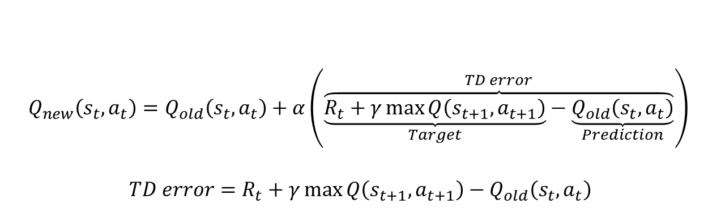
Deep Q-Learning
Updating the Weights of the Network at the End of each Episodes
Changing the Hyperparameters and going to
Next Episode
Choosing the Architecture of the Network
Choosing the Best Action
Storing the Reward, Action, and Observation
$$Q_{new}\left(s_{t},a_{t}\right)=Q_{old}\left(s_{t},a_{t}\right)+α\left(\overset{TD error}{\overbrace{\underset{Target}{\underbrace{R_{t}+γ\max{Q\left(s_{t+1},a_{t+1}\right)}}}−\underset{Prediction}{\underbrace{Q_{old}\left(s_{t},a_{t}\right)}}}}\right)$$
$$TD error=R_{t}+γ\max{Q\left(s_{t+1},a_{t+1}\right)}−Q_{old}\left(s_{t},a_{t}\right)$$

Slide 10
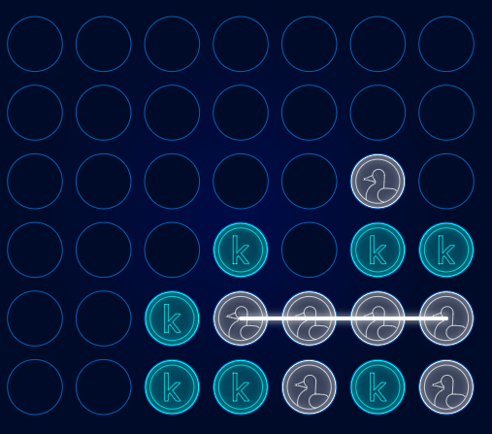
Connect4
Environment:
kaggle-environment
References:
https://www.kaggle.com/code/ajeffries/connectx-getting-started/notebook
https://www.kaggle.com/code/gordotron85/teaching-an-agent-to-play-connect-4
https://medium.com/@louisdhulst/training-a-deep-q-learning-network-for-connect-4-9694e56cb806

Slide 11
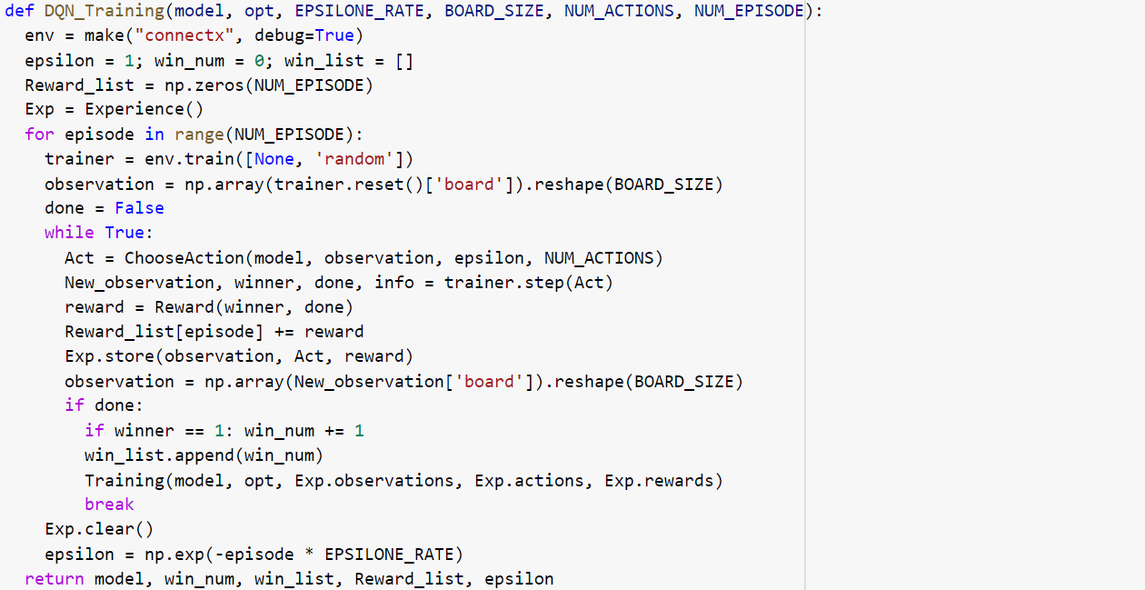
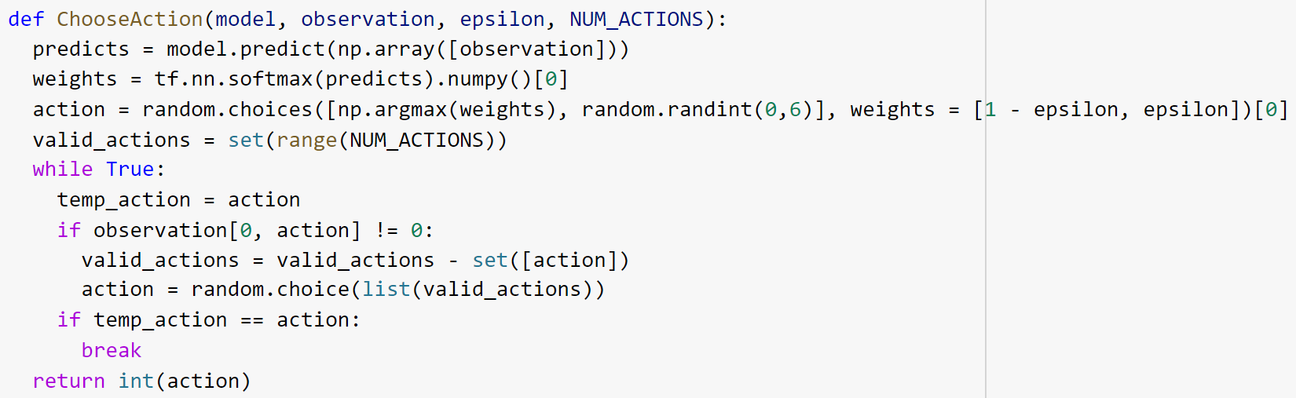
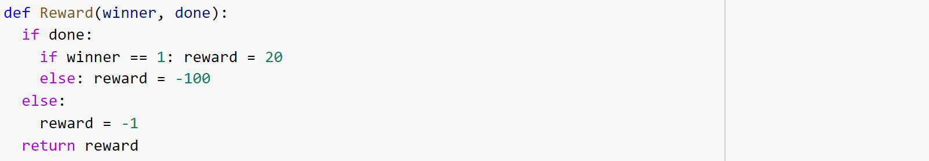
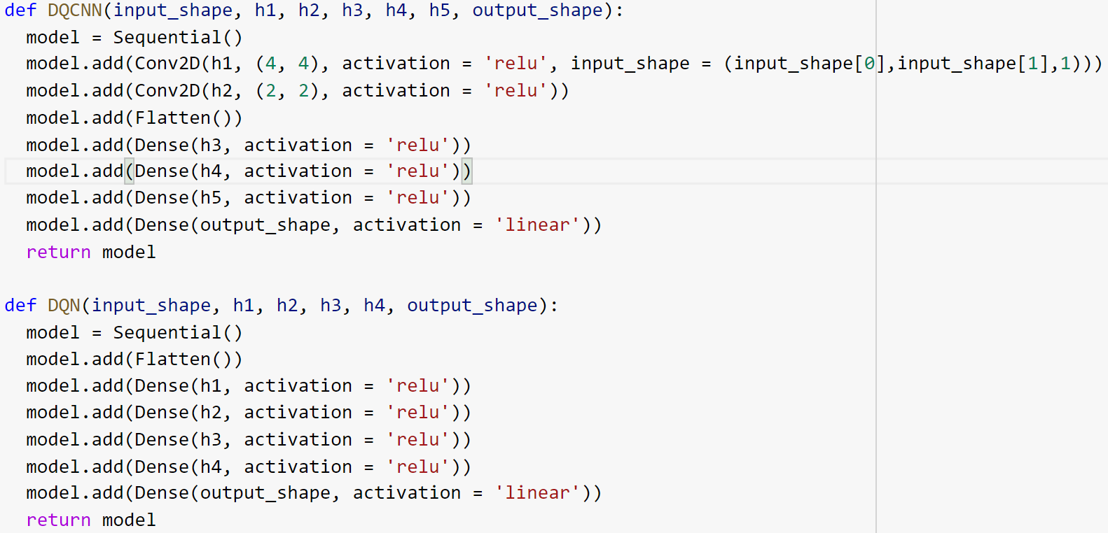
Implementation & Results
Updating the Weights of the Network at the End of each Episodes
Changing the Hyperparameters and Going to
Next Episode
Choosing the Architecture of the Network
Choosing the Best Action
Storing the Reward, Action, and Observation

Slide 12
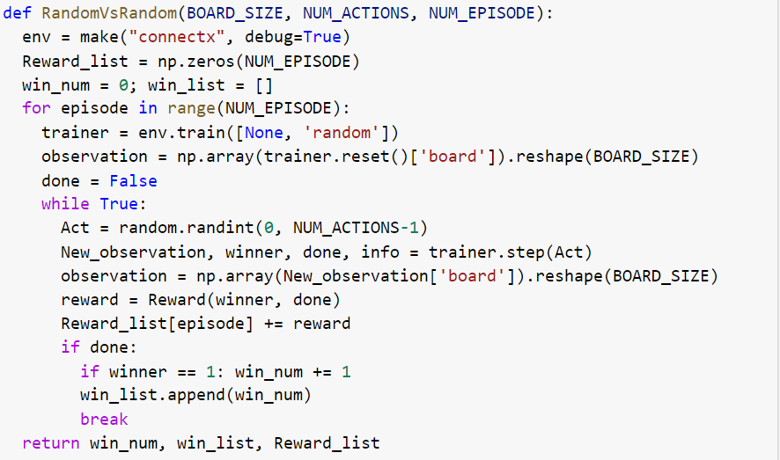
Implementation & Results
Comparing the Model with Random Agent

Slide 13
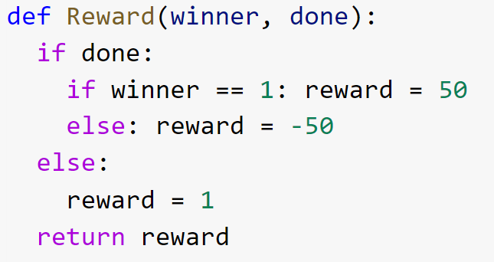
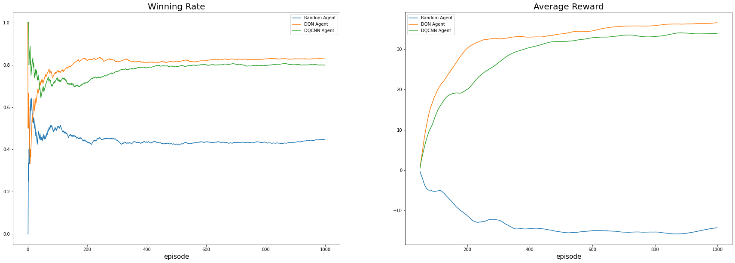
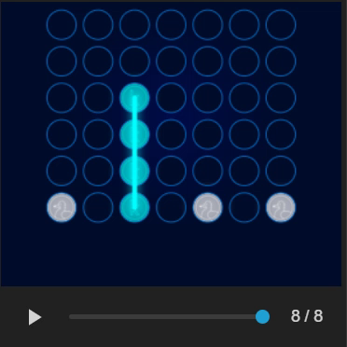
Implementation & Results
Comparing the Model with Random Agent
Reward Shaping!

Slide 14
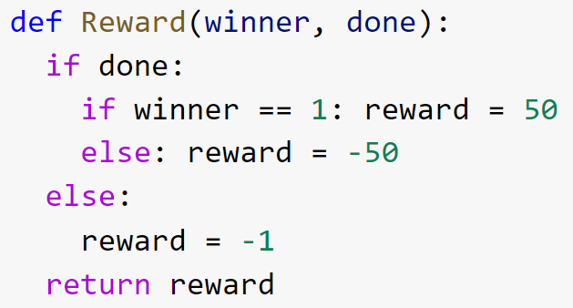
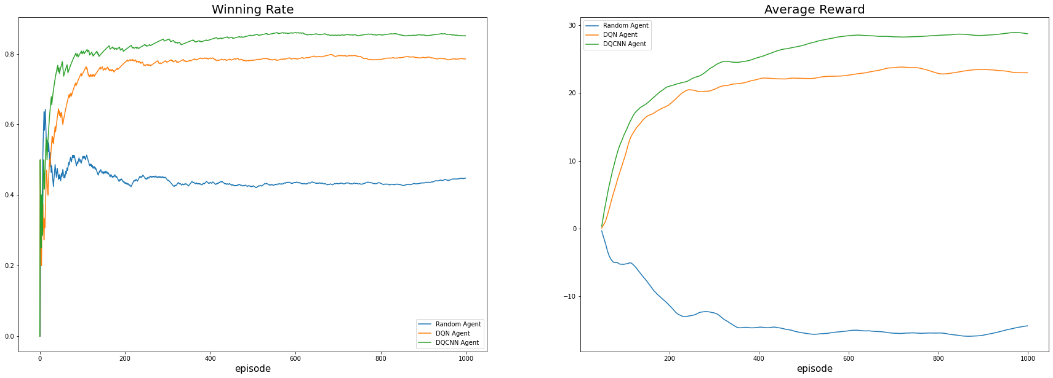
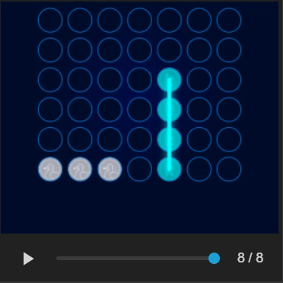
Implementation & Results
Comparing the Model with Random Agent

Slide 15
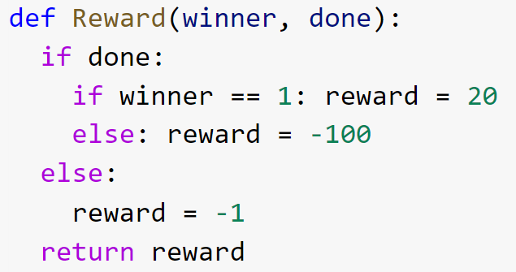
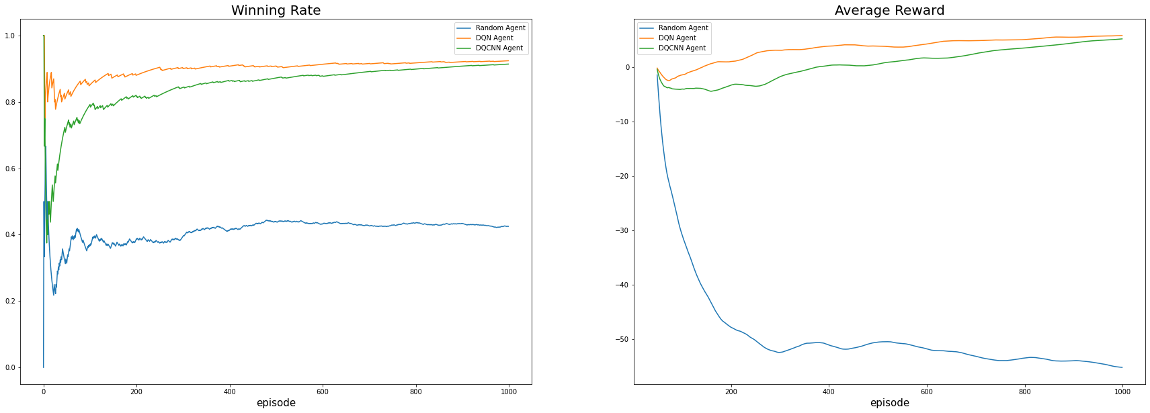
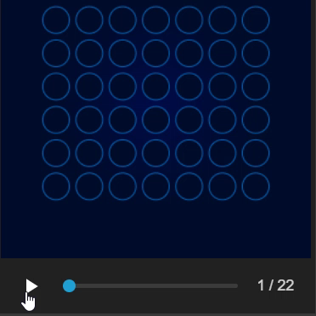
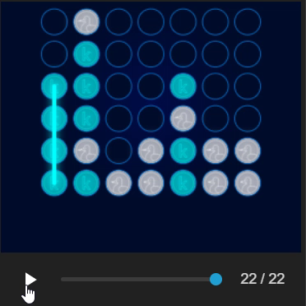
Implementation & Results
Comparing the Model with Random Agent

Slide 16
Thank You

